Slide 1





JavaScript Advanced
Course Overview
Advanced
JavaScript Advanced
SoftUni Team
Technical Trainers
Software University
http://softuni.bg

Slide 2



Table of Contents
Course Objectives
Course Program
Trainers Team
Course Schedule
Exams and Evaluation
Learning Resources

Slide 3
Have a Question?
sli.do #JSCORE

Slide 4






SoftUni Diamond Partners

Slide 5






SoftUni Diamond Partners

Slide 6

JavaScript Advanced
Fundamentals
Course Objectives & Program

Slide 7

Course Objectives
The JavaScript Advanced course provides
Advanced coding skills for the JS language
Extends the JS Fundamentals course
Covers DOM, advanced functions, IIFE, object composition, unit testing, classes and inheritance, modules, transpilers, exceptions, generators, iterators
What is NOT covered?
JS technologies (AJAX, AngularJS, ReactJS, promises)

Slide 8
Course Topics
DOM and BOM, Manipulating the DOM Tree
jQuery: Simplified DOM and Events
Advanced Functions: IIFE, this, call, apply, bind
Object Composition and Revealing Modules
Unit Testing with Mocha and Sinon
Classes and Members
Class Inheritance and Prototype Chain
Modules, Babel Transpiler, CommonJS

Slide 9
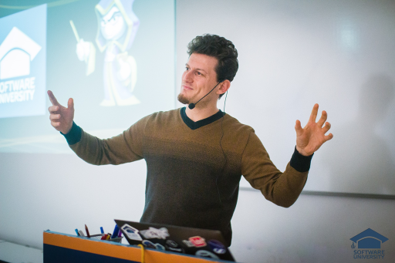
The Trainers Team

Slide 10

Trainers Team
Nikola Andreev
Developer
Passionate about Java and JavaScript
Experienced technical trainer
Top performing student from SotfUni

Slide 11

Trainers Team
Ivaylo Dimitrov
4+ years experience in the IT (HTML, CSS, JavaScript, C#, SQL,
Windows Server)
Student with excellent grades in Software University
Technical Trainer in Software University

Slide 12

Trainers Team
All Of You
Passionate students
Students with excellent grades in Software University
WIZARDS OF THE FUTURE

Slide 13
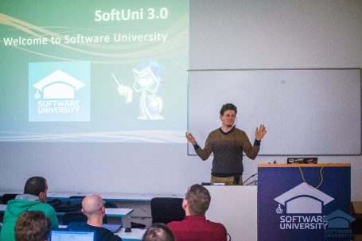


JavaScript Advanced
Course Details and Schedule

Slide 14
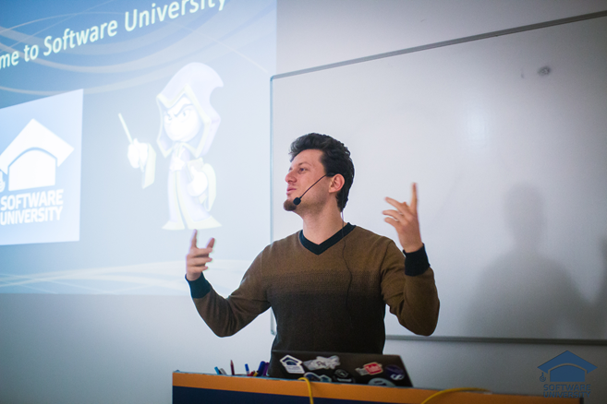
Training Duration and Schedule
Lessons: ~ 20 hours (onsite + YouTube videos)
Practical exercises (in class): ~ 40 hours
Homework: ~ 0-50 hours
Time frame
14-May-2018 – 10-June-2018

Slide 15


Why English?
Why the slides are in English?
English is the native language of the software engineers
Specific terminology should be in English
Translations are inaccurate and funny
Just learn English!
No excuses

Slide 16


Your RFID Chip
Students can either
Take RFID chip from SoftUni
Or use their own chip / card (125 KHz)
Register your chip number in your SoftUni profile: https://softuni.bg/users/profile/show
Check-in at the reception every time when you come in SoftUni
See your last visits in your profile: https://softuni.bg/users/profile/show

Slide 17


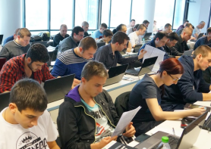
JavaScript Advanced
Evaluation Criteria

Slide 18
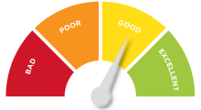

Scoring System for the Course
Mandatory:
Final exam – 85%
Exercises & homework – 15%
Bonuses:
Presence in class – 5% bonus
Forum activity – bonus up to 5%

Slide 19


Homework Assignments & Exercises
Your homework is mainly work in class!
Lesson days → slides + live demos + exercises
Exercise days → only exercises
How to submit your homework?
Submitted in the judge system
Homework assignments are due in 7 days
Due for both lesson days and exercise days

Slide 20










Resources
What We Need Additionally?

Slide 21



Course Web Site, Forum and FB Group
Official web site:
Official discussion forum:
Official Facebook group:
softuni.bg/courses/javascript-advanced
softuni.bg/forum/categories/19
https://www.facebook.com/groups/SoftUniJSCoreMay2018/

Slide 22

The Programming Basics Slides and Videos
All lecture slides, videos, homework assignments, projects and other resources are open content, available for free
Visit the course web site to access the course resources

Slide 23



Recommended Software
Software needed for this course:
Noje.js – https://nodejs.org
WebStorm – https://jetbrains.com/webstorm/
Optionally:
Visual Studio Code – https://code.visualstudio.com

Slide 24










JavaScript Advanced – Course Overview
https://softuni.bg/courses/programming-fundamentals

Slide 25
License
This course (slides, examples, demos, videos, homework, etc.) is licensed under the "Creative Commons Attribution-NonCommercial-ShareAlike 4.0 International" license

Slide 26





Free Trainings @ Software University
Software University Foundation – softuni.org
Software University – High-Quality Education, Profession and Job for Software Developers
softuni.bg
Software University @ Facebook
facebook.com/SoftwareUniversity
Software University Forums
forum.softuni.bg

